Slide 1
Personalities and their interest
Emilio Ramos Monzalvo
Syracuse University

Slide 2
Problem statement
Dataset: 4 personality groups with 217 interests.
An interest can range from do you like chess to do you like swimming?
Only answer is either yes or no.
Can we predict the group using the interests?f

Slide 3
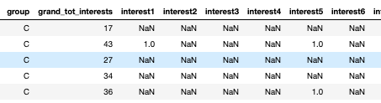
Preprocessing the Data
Dataset is extremely sparse.
We need to reduce the number of columns in order to perform an algorithm that is efficient for this problem.
Simple checks like not many or close to all individuals liking certain interests can help us reduce the number of interests extensively.

Slide 4
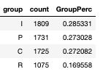
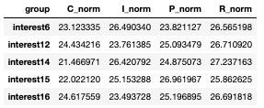
Preprocessing the Data
Another approach to getting rid of irrelevant columns is to find interests that are well represented among all groups.
Firstly we need to make sure the percentages are corresponding to the population as the Group R only represents 16.9% of the population.

Slide 5
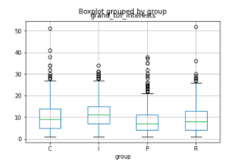
Preprocessing the Data
Total number of interests per individual can describe whether the individual represents the group or not.
Individuals with no interests have no contribution to the model unless they happen mostly within one group (Which is not the case)
Individuals with 28 interests or more were taken out since they were 3 standard deviations away from the mean (I.e., anomalies).

Slide 6
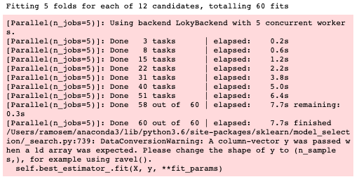

Random forest
Grid Search CV:
Parameters:
'criterion':['entropy’]
‘n_estimators’:[10, 30,50,70]
'max_depth’:[10,20, 35]
Best Model:
Parameters:
criterion = entropy
Max depth = 25
N Estimators = 70
Best Accuracy: 92.3%

Slide 7
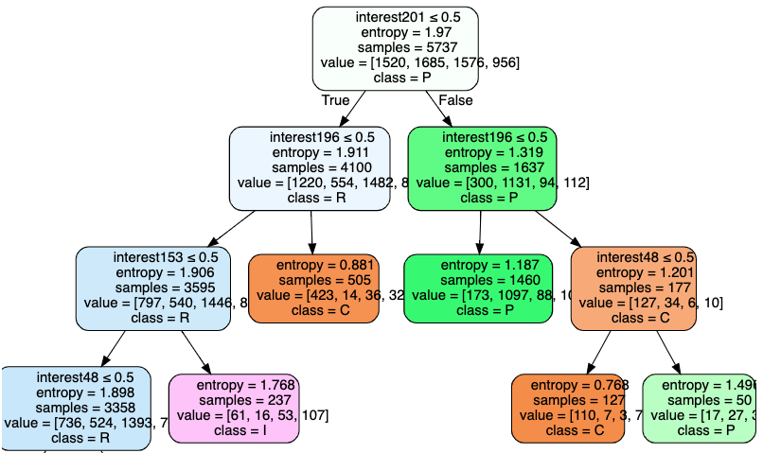
Decision Tree
Decision Tree leads to a great visualization of the most splitting interests because of the criterion setting set to Entropy.
We can see how Interest 201 is the most controversial interest.

Slide 8
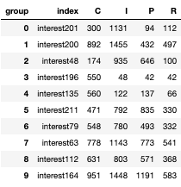
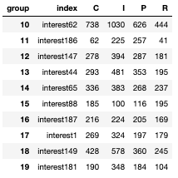
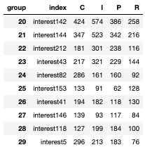
Results

